Slide 1

SC1015 Mini Project – Airline Passenger Satisfaction
Yaxin (U2220733G)
Nivedha (U2220745J)
Kay (U2220423G)
Notes:
Good day everyone, we are yaxin, nivedha and kay from team 9. we will be presenting abt SC1015 Mini Project which is Airline Passenger Satisfaction dataset, source is taken from kaggle

Slide 2
Table of contents
01
Introduction
02
Problem Formulation
03
Data Preparation
04
Exploratory Data Analysis
05
Model Building &
Machine Learning
06
Conclusion

Slide 3

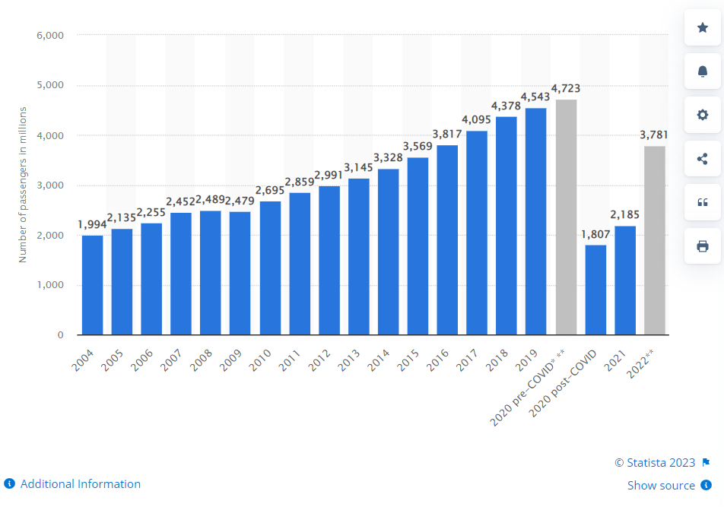
How to deal with
High Demand in Aviation Industry:
Post Pandemic Travel Trends
Introduction
Notes:
Background: With the recent increase in demand for air travel after the pandemic, the aviation industry is facing new challenges to maintain and improve customer satisfaction. As we are interested in the field, we decided to analyze customer satisfaction data for an airline company and identify significant variables, patterns, and trends that could impact customer service.
ideas: Airline businesses around the world are decimated by Covid-19 as most international air travel has been grounded. demand for air travel is high as people rush back for overseas holidays, especially SG who has zero domestic flight in its island. To find out What can airlines prepare to give themselves a competitive edge when the crowd finally arrives? To answer this business problem, a classification model is created from the flight satisfaction survey data to identify the critical factors that lead to customer satisfaction.
EDA- data cleaning – remove ID, remove rating 0
Analyzing satisfaction level of Diff Class based on diff services
analyze whether gender and age group have an effect on satisfaction levels?998
conclude the satisfaction levels of both first-time and existing passengers and determine if they are likely to use our airline again?
Whether Dep delay is effecting on satisfaction lvl – we categorized into diff flight(same distance and same delay considered as same flight)
Heat map – explaining how some variables are depending on each other for satisfaction lvl- eg; if the airline passenger's flight time is delayed for a certain time at departure, then the flight time will also be delayed by the same amount of time at landing
Conclusion – which services have the greatest impact on customer satisfaction based on diff age categories??
Lazy prediction is used which model to choose in prediction
To conclude the mainly influenced services, there are top 4 model that we have chosen - Decision Tree, random forest, LGBM classifier, cross validation grid results.
to find out which types of services are causing customer dissatisfaction, we need to investigate and identify the areas of the airline's services that are not meeting customer expectations

Slide 4

How can airline improve services to increase passenger satisfaction?
How different variables affect the overall satisfaction in different generation groups?
Motivation - Problem Formulation
Notes:
Motivation: Our goal is to give suggestions to the airline company on which categories of services are mainly affecting customer satisfaction and which areas need improvement to attract new customers and retain loyal ones. Through our analysis, we hope to provide insights that can contribute to the improvement of customer service in the aviation industry.
Passenger satisfaction is a critical factor for the success of any airline. Satisfied passengers are more likely to become loyal customers, provide positive reviews, and recommend the airline to others. On the other hand, dissatisfied passengers may switch to other airlines or share negative feedback, which can impact an airline's reputation and bottom line. Therefore, understanding the factors that influence passenger satisfaction is essential for airlines to improve their services and maintain customer loyalty.
Motivation
Chking on each variable
Set The Stage
Present your Exploratory Data Analysis and some initial data-driven Insights from the dataset.
You MAY also mention how you are planning to set up the Analysis / ML problem for this case.
You MUST mention how you collected / curated / cleaned / prepared the data for this problem.
Did you only use tools and techniques learned in this course? What ELSE did you learn / try?
Next 3 minutes (approx.)

Slide 5

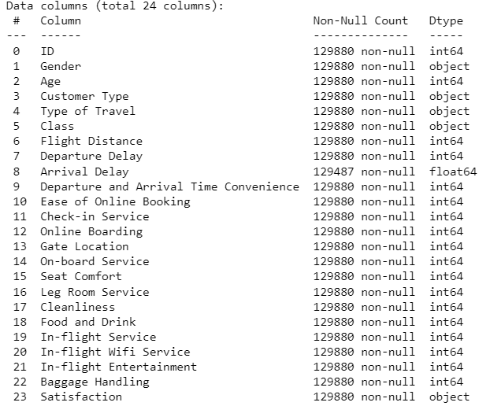
What are the variables included in data set?
Notes:
The variables presented above are the total variables in the dataset that we will be exploring

Slide 6

Data Preparation for EDA
Removing unnecessary column ("ID")​
01
Dealing with Missing value (Arrival Delay)
02
Handling outliers ("Departure Delay" & "Arrival Delay" & "Flight Distance")
03
Replacing rating '0' with MEAN ('0' means not applicable)
05
Split the dataset according to generations
06
Checking balance
04
Notes:
Speech- Before conducting exploratory data analysis (EDA), data preparation is crucial to ensure the data is clean and relevant.
In this process, unnecessary columns such as the "ID" column can be removed which is like a serial number and ni=ot required for EDA to simplify the data.
Handling missing values is also an important step, such as dealing with missing data in the "Arrival Delay" column.
Outliers in the "Departure Delay," "Arrival Delay," and "Flight Distance" columns should also be addressed to avoid skewing the data analysis.
Checking the balance of the dataset is essential to ensure that the data is not biased towards a particular category or group.
To handle the 0 rating values where normally start from rating 1-5 , the value of '0' can be replaced with the mean rating value (since '0' usually means that the rating is not applicable).
Lastly, to gain insights into the different generations, the dataset can be split according to diff generation group

Slide 7
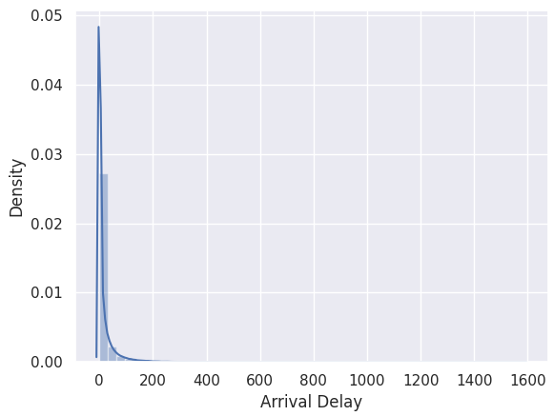
Missing value for "Arrival Delay" - Median
Skewed arrival delay graph requires median instead of mean for analysis
Missing value for arrival delay is filled with median value.
Notes:
In the category of arrival delay, we observed that the graph was skewed, so we decided to use the median instead of the mean, which is typically used for normal distributions.

Slide 8
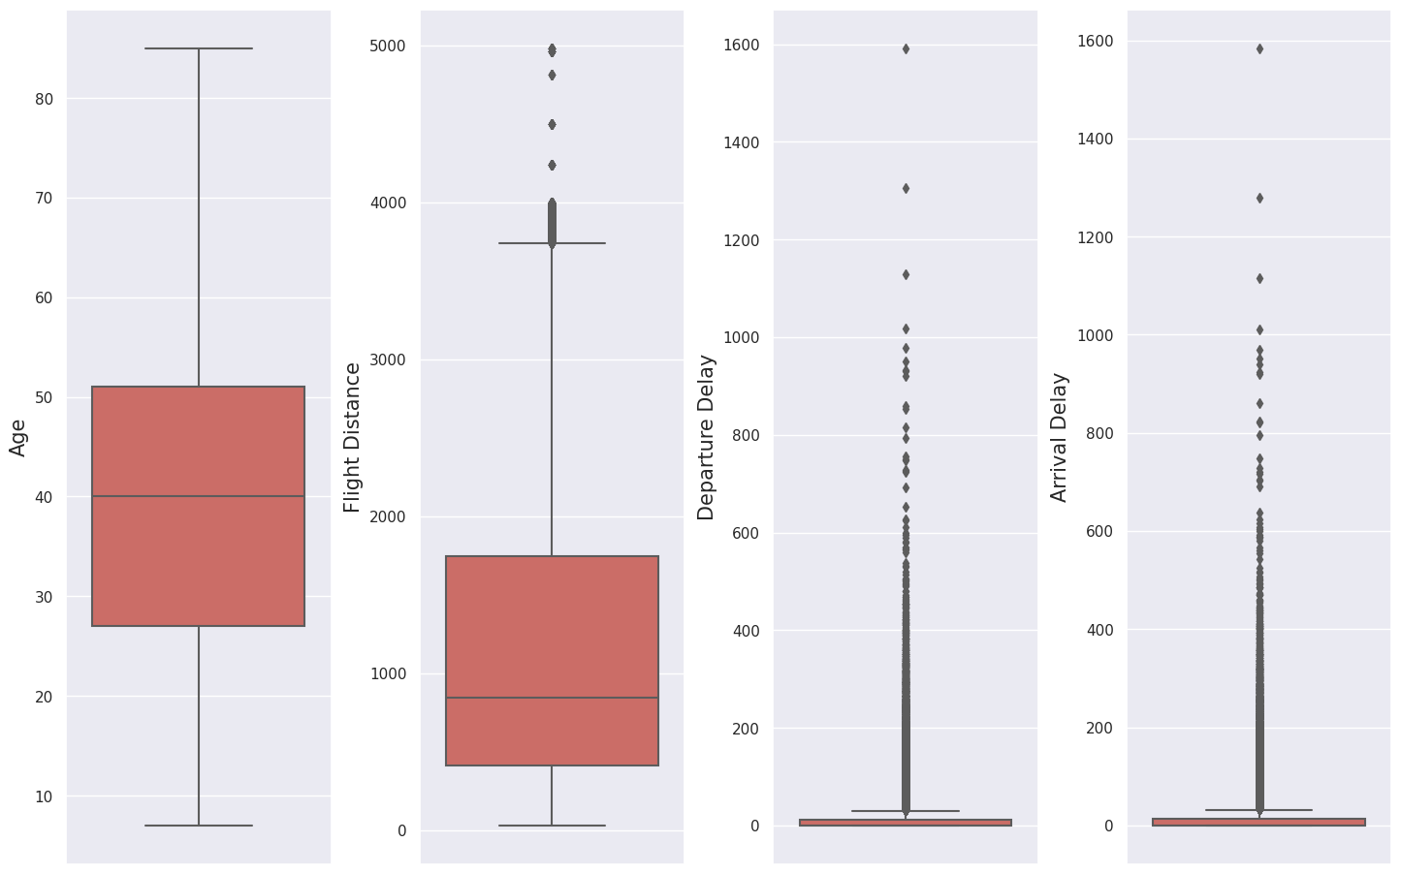
Handling Outliners
-Flight Delay & Flight Distance
Notes:
Speech- When we looked at the data on arrival and departure delays, we found that there were many outliers that were affecting in prediction of which factors were affecting passenger satisfaction levels. Despite the possibility that passenger satisfaction may be affected, we decided to break down the delay time into smaller segments and investigate whether passengers still feel satisfied even after experiencing a delay, or whether they tend to feel dissatisfied. Our goal is to better understand how flight delays affect passenger satisfaction .

Slide 9
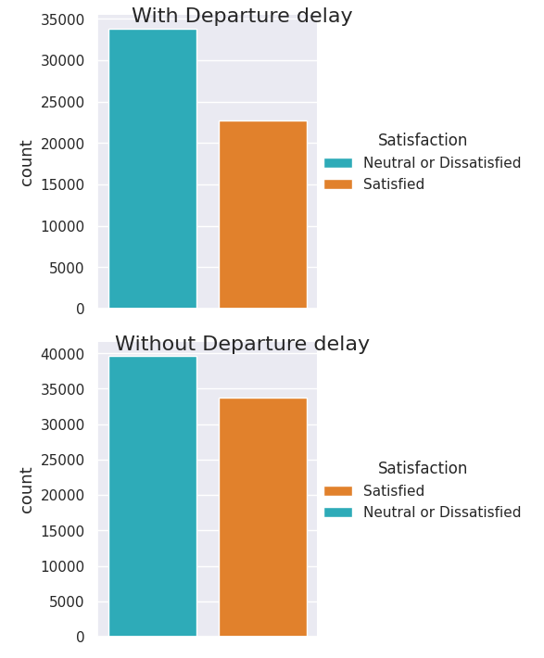
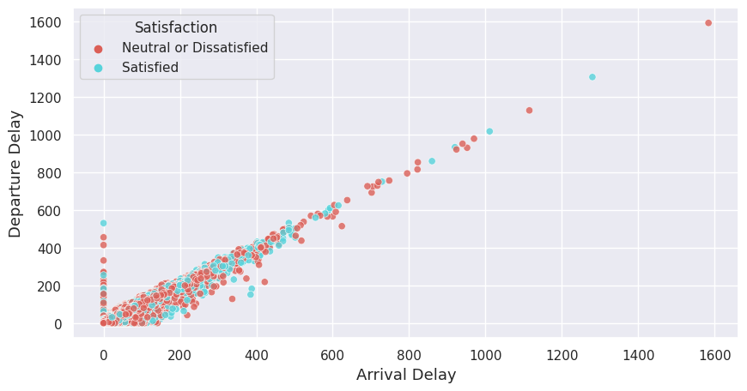
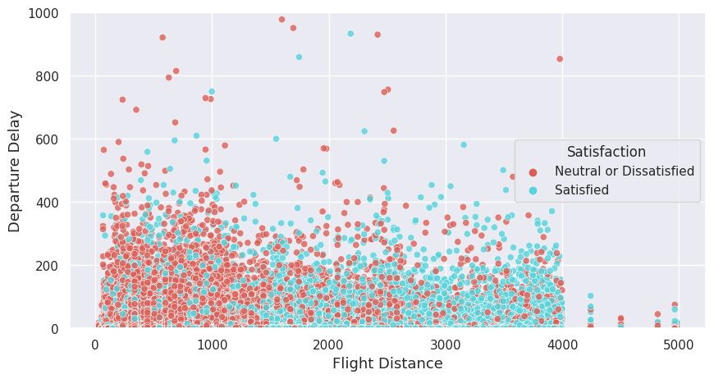
Satisfaction VS Flight delays ?
Relationship between Arrival Delay and Departure Delay
Departure and arrival delays have a linear relationship.
Majority of passengers are fine with slight departure delay for longer flights.
Travelers with short flight distances are unhappy with delayed departure.
Analysis before handling outliers
Notes:
Speech-
Before handling the outliner, let us do an analysis between satisfaction and delay.
(right top graph)Departure and arrival delays seem to have a linear relationship.
(right bottom) When there is flight delay, The majority of passengers feel fine with the slight delay in departure with longer flight which means departure delay is not a factor for long-distance flights. However, travelers with short flight distances seem unhappy with the delayed departure.
(left) Even when no flight delay, Majority of customers reported feeling unsatisfied. This suggests that other factors besides flight delay may be contributing to overall customer dissatisfaction
The airline should consider investigating and addressing these additional factors to improve customer satisfaction.

Slide 10
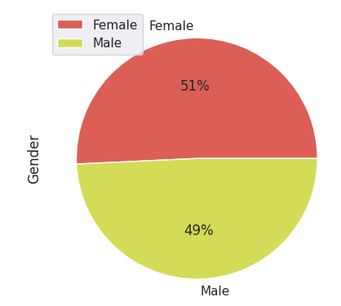
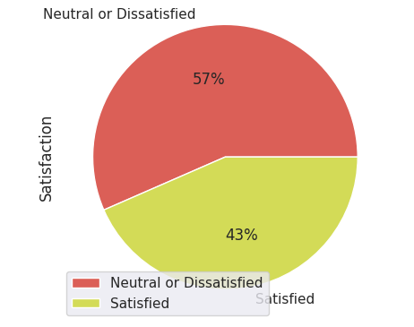

Overall Satisfaction Level :
By Gender:
Survey is balanced and unbiased with 43% and 57% numbers being tolerable.
No modification required for the data.
Gender has negligible impact on satisfaction.
Notes:
Check balance
Speech-The first graph shows that most people feel neutral or dissatisfied with the overall satisfaction level, indicating that there is room for improvement in the airline's services. And the percentage for satisfied and dissatisfied is 43 and 57 respectively, so the data is not very balanced but still tolerable so we consider the survey is balanced. Therefore, we do not need to make any modifications to the data.
From the second graph, we can say the data is balanced for gender as the percentage of males and females is almost the same. This implies that the dataset has an equal representation of both male and female categories.

Slide 11

Exploratory Data Analysis

Slide 12
Gender
Pre-boarding and onboarding
Age
Class Type
Customer Type
Let's Explore Satisfaction Ratings Across Different Categories
Notes:
Speech: We're looking at satisfaction ratings in different categories like gender, customer type, pre-boarding and onboarding, age, and travel class type.
We want to see if there are any differences in satisfaction levels across these categories and understand what factors impact passenger satisfaction.
This analysis can help airlines improve the overall customer experience for all passengers.

Slide 13
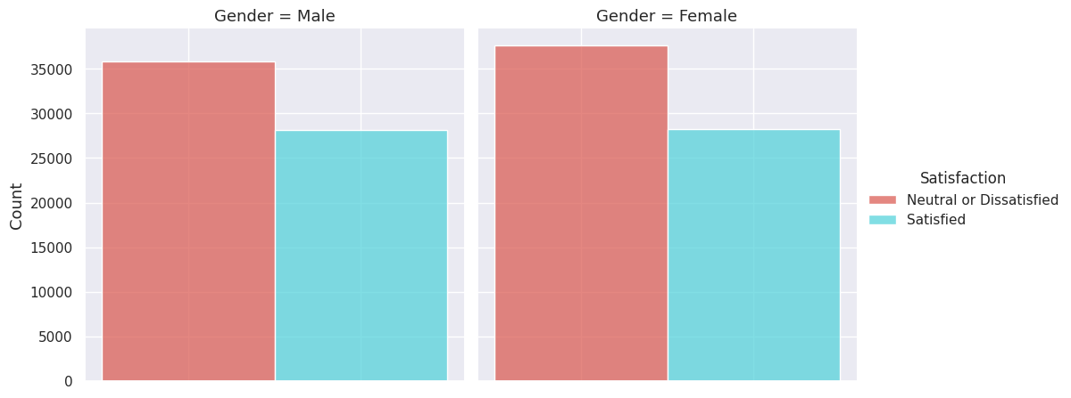
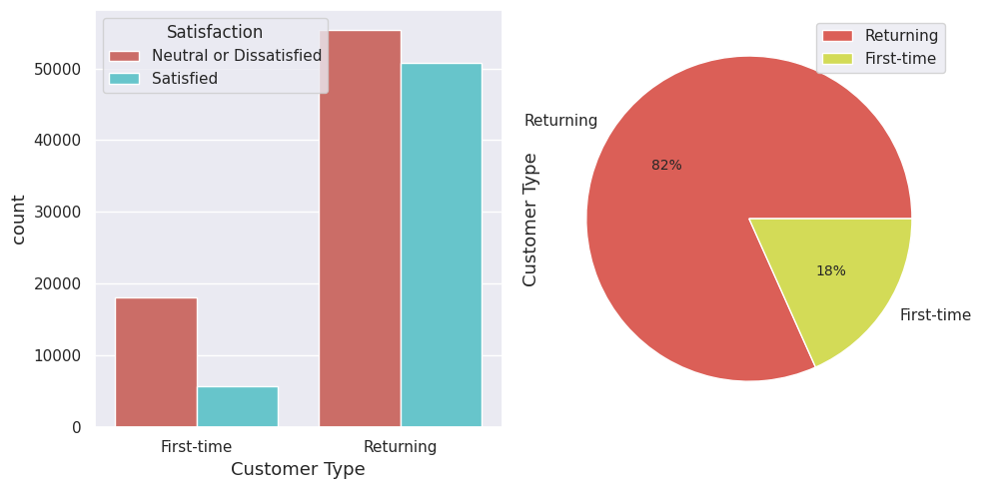
Gender
– Male & Female
Customer Type
– First Timer & Existing customer
Gender has negligible impact on satisfaction
First-time passengers are generally dissatisfied with the flight
82% of passengers are returning customers
High level of dissatisfaction among both first-time and loyal customers
Notes:
Speech-
Gender has a negligible impact on satisfaction, as both genders reported similar levels of satisfaction or dissatisfaction based on their ratings.
Our observation suggests that first-time passengers are generally dissatisfied with the flight, while 82% of the passengers are returning customers.
The data shows that despite having a high number of returning passengers, there is a significant level of dissatisfaction among both first-time and loyal customers.
We observed that the majority of first-time passengers are not satisfied with their flight experience, while a significant portion (82%) of the passengers are returning customers. However, regardless of customer loyalty, there appears to be a high level of dissatisfaction among the passengers. This suggests that the airline should prioritize enhancing the overall customer experience to improve satisfaction and retain loyal customers.

Slide 14
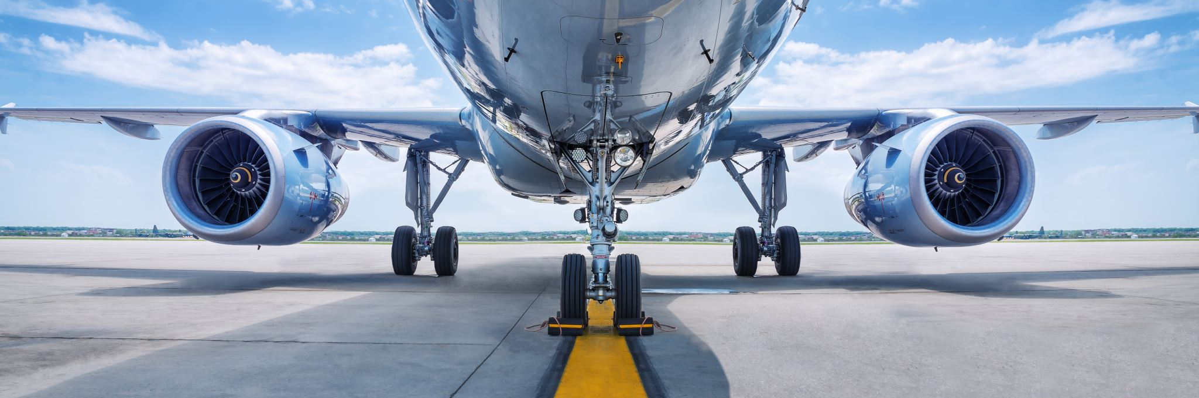
Exploring How Service Ratings for Pre-boarding and Onboard Services Affect Passengers' Flight Experience
Notes:
Speech-- we're going to explore how pre-boarding and onboard services affect passengers' flight experience. We'll be looking at various ratings for services like check-in, boarding, and food to see how they contribute to overall satisfaction levels

Slide 15
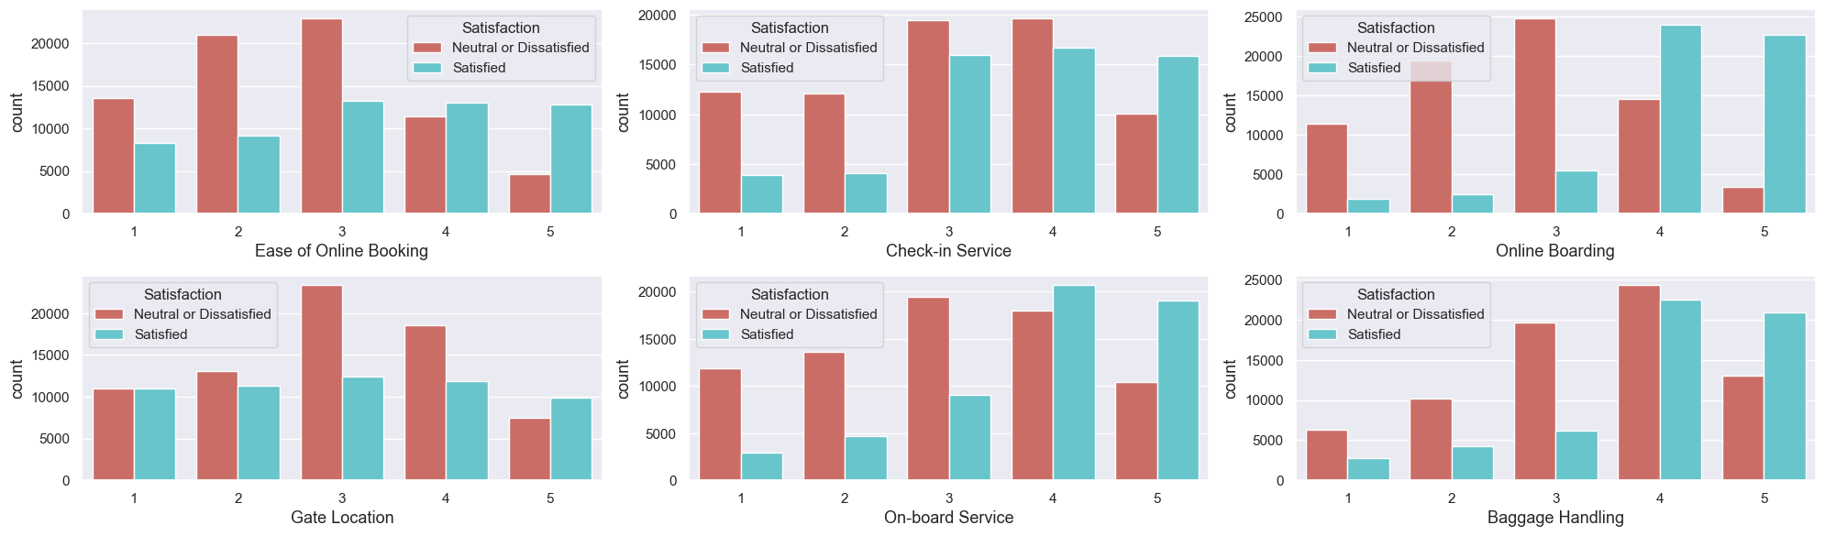
Analyzing on Pre-Boarding services
Baggage handling, check-in, and gate location received low satisfaction ratings of 3-4.
Online booking and on-board services received higher satisfaction ratings.
Suggestions to improve the pre-boarding experience by addressing baggage handling, check-in, and gate location services.
Notes:
#### Observations:
#### Majority of passengers rated Ease of Online Booking as 1-3.
#### Passengers seem to be satisfied with Baggage Handling since more than half of people rated it as 4-5.
#### Online Boarding and On-board Service play a critical role in determining passenger satisfaction since a majority of those who rated it between 1-3 expressed dissatisfaction with the overall service.
#### The airline should prioritize improving the dissatisfactory pre-boarding services to enhance the overall customer experience.

Slide 16
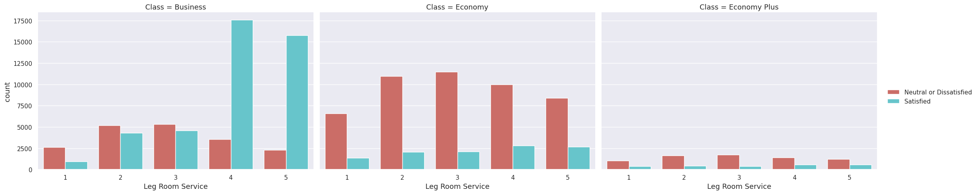
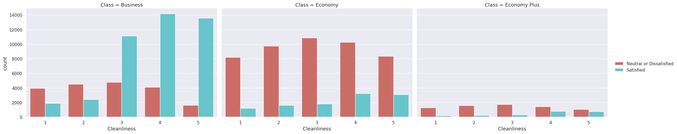
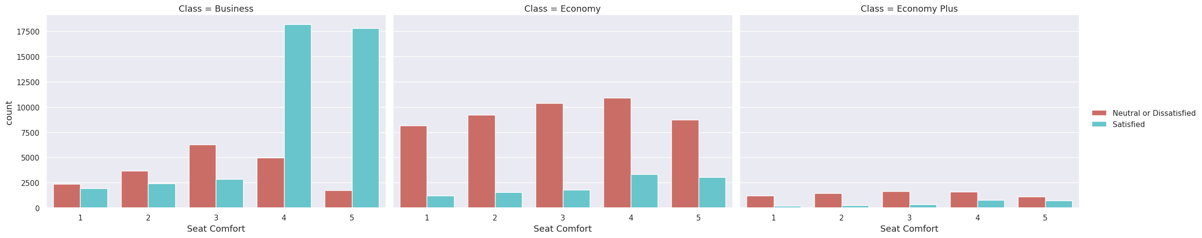
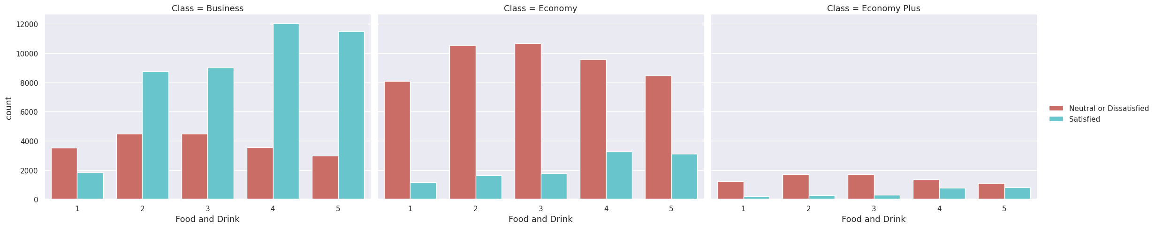
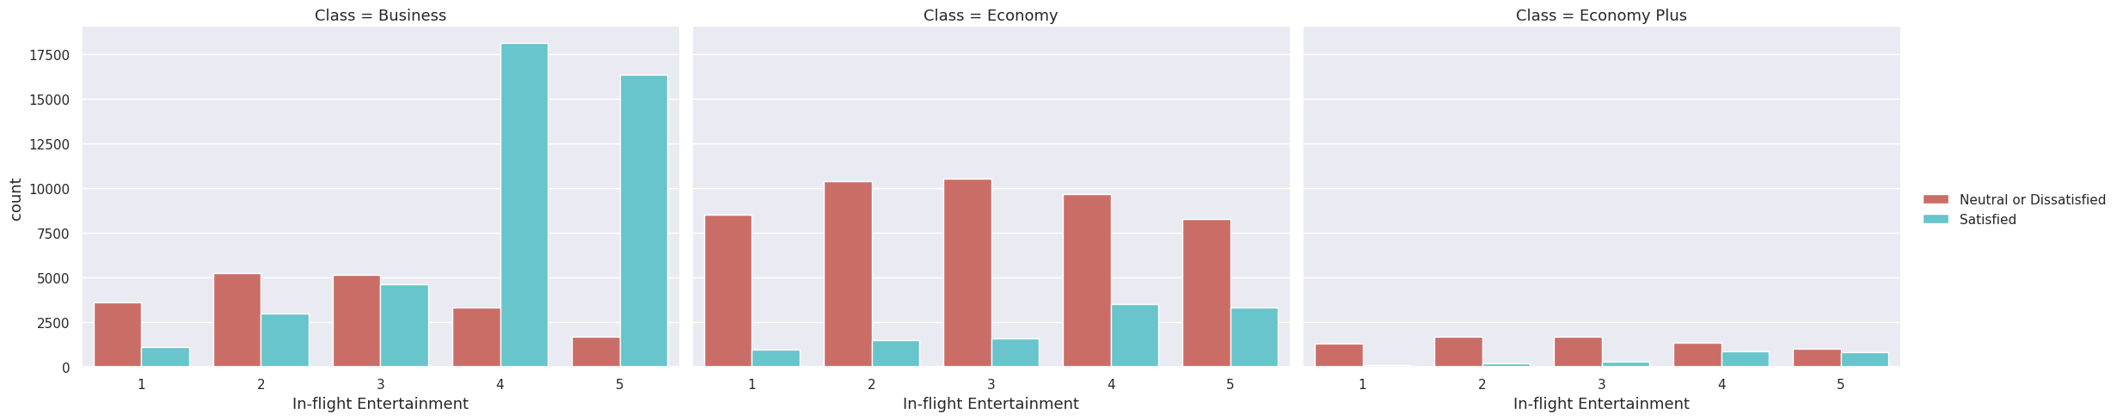
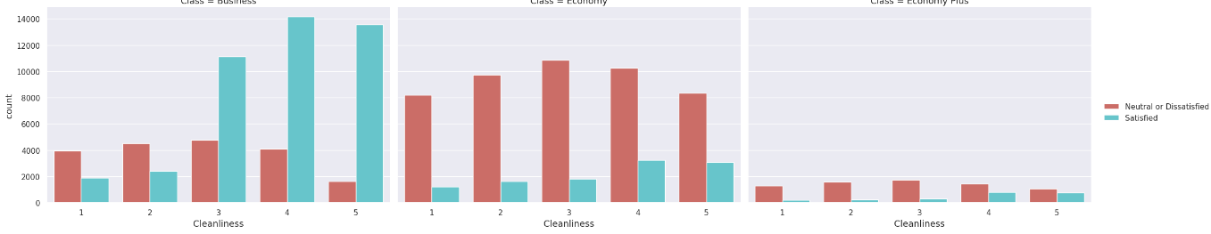
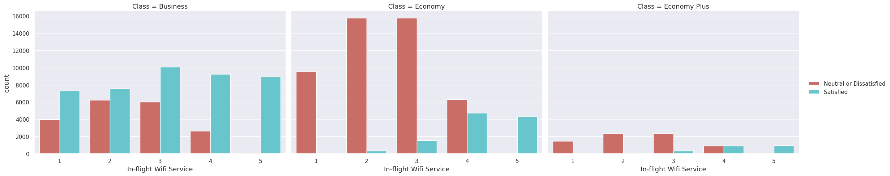
Analyzing on In-Flight services
Comparing the ratings for different classes
Business
Economy
Economy Plus
Business​
Economy
Economy Plus
Leg room
Food & Drink
Seat Comfort
Food & Drink
Cleanliness
Entertainment
Wifi
Notes:
Speech -
We conducted a study to determine if there were any differences in passenger satisfaction levels between different travel classes.
We found that Business Class passengers reported significantly higher satisfaction levels, particularly with regard to spacious leg room and most in-flight services, but were less satisfied with food and drinks. Economy Class passengers generally reported average satisfaction levels, with some slight dissatisfaction with wifi, while Economy Plus passengers had no significant satisfaction ratings across all services, with fewer passengers in this class.
One area where the airline excelled was in maintaining cleanliness during flights, with both Economy and Business classes receiving average to above-average ratings in this regard. Additionally, this shows that flight crews provided attentive service to all customers, regardless of their travel class, which contributed to overall high satisfaction ratings.
#### Observations:
#### Business class passengers gave significantly higher satisfaction ratings for their spacious leg room and almost all in-flight services, while feeling average for wifi service.
#### Majority of passengers from Business Class are satisfied with overall flight service based on these in-flight services.
#### Economy class passengers mostly rated the services as average, but expressed slight dissatisfaction with wifi service, while expressing slight satisfaction with in-flight service.
#### Most of passengers from Economy Class were dissatisfied with overall flight service.
#### Economy Plus passengers rated all services as so-so, with fewer passengers choosing this class.
#### Based on the ratings,it seems that the wifi speed in the business class section is average, whereas passengers perceive the wifi services in the economy class area to be of poor quality.
#### It conclude that the airline is attentive and provided equal service to all customers, resulting in relatively high satisfaction ratings across all classes.

Slide 17
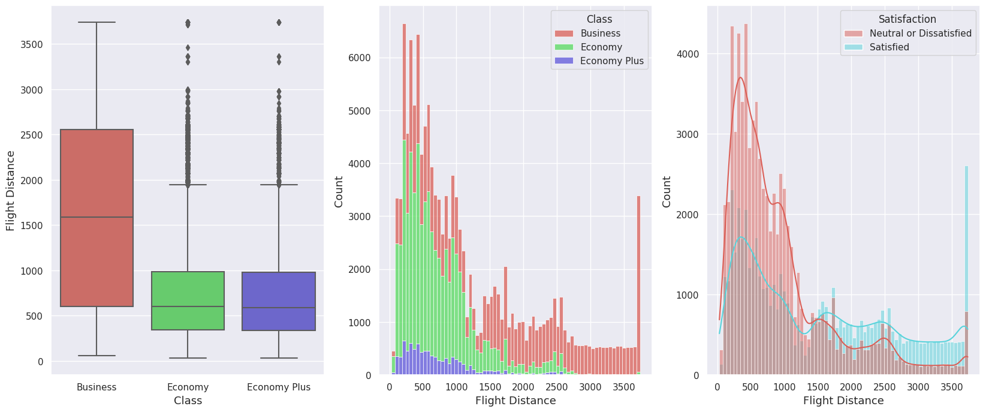
Examining Passenger Travel Class Preferences and Satisfaction Levels Across Varying Flight Distances
Business Class preferred for long-distance and business travel
Longer flight distances associated with higher satisfaction levels
Business Class amenities may contribute to increased satisfaction on longer flights
Notes:
So, what we found is that most people who have long-distance flights or are traveling for business tend to go for Business Class. And it seems like those passengers who have longer flight distances are generally more satisfied with their flight experience, maybe because they get access to those fancy Business Class facilities

Slide 18
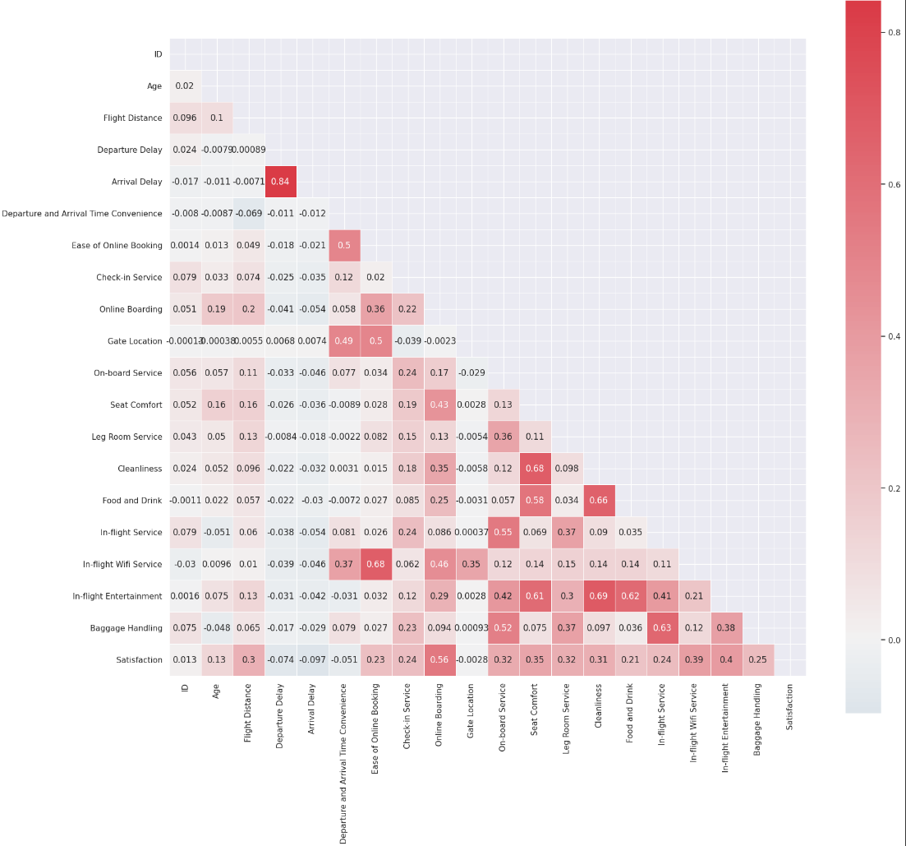
Variable Correlation Analysis using Heatmap
It is estimated that the length of delay in arrival depends on the length of delay in departure which is linear. If the airline passenger's flight time is delayed for a certain time at departure, then the flight time will also be delayed by the same amount of time at landing.
Notes:
"Heatmap analysis helps prioritize influential variables for customer satisfaction."
, it is estimated that the length of delay in arrival depends on the length of delay in departure which is linear.
So if the airline passenger's flight time is delayed for a certain time at departure, then the flight time will also be delayed by the same amount of time at landing (provided the plane does not accelerate during the flight to make up for wasted time and also as long as there are no other technical constraints

Slide 19
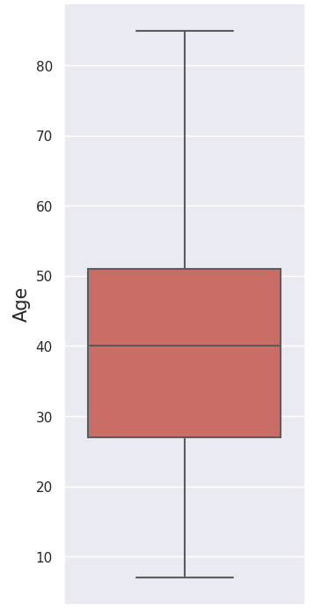
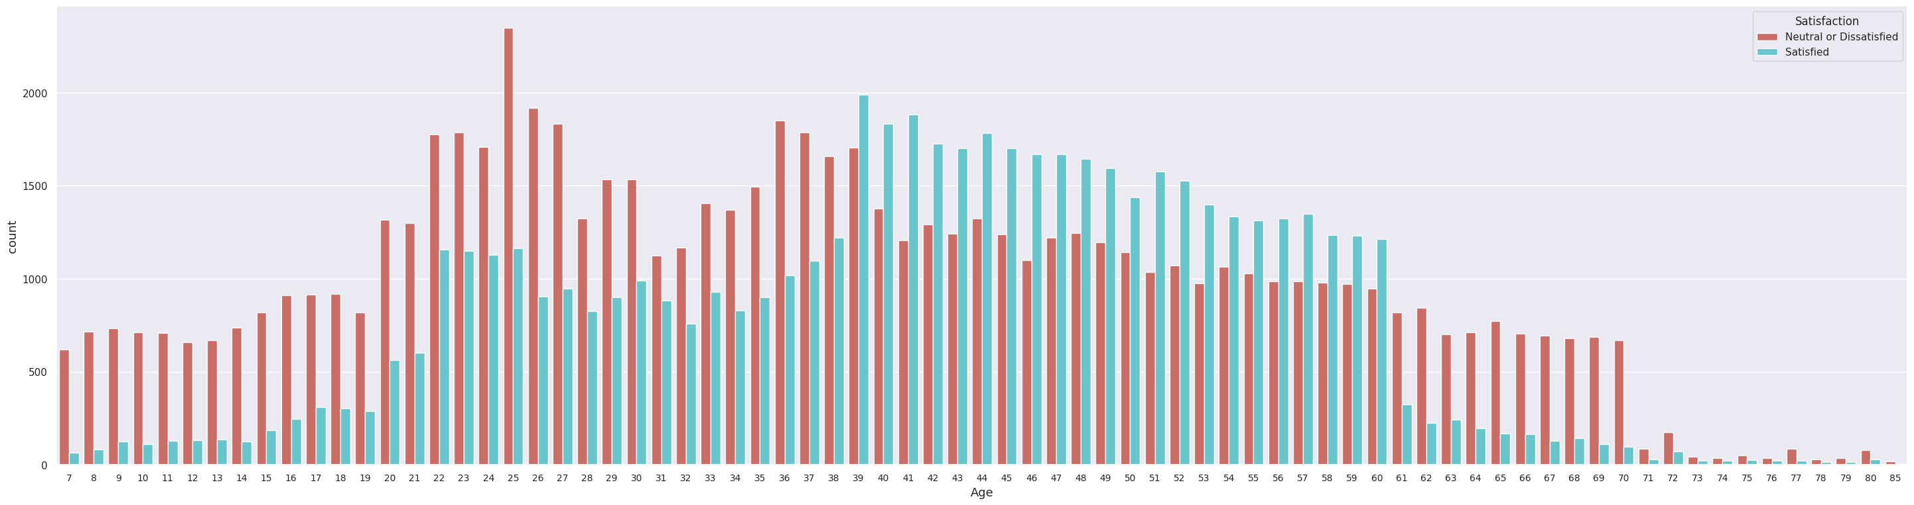
Comparing the satisfaction level by Age
Age group 39-60: Higher satisfaction levels, indicating higher expectations.
Age group 20-39: Mostly unsatisfied with the services.
Children and elderly: More likely to feel not satisfied or neutral.
Notes:
The analysis provides insights into the satisfaction levels of customers based on their age, helping to identify any age-related patterns or trends in customer satisfaction. As from the boxplot, our majority of customers age is ranging from 30 to 50.
So, from the analysis, we found out that the age group of 39-60 have higher expectations, which is clear from their higher satisfaction levels compared to other age groups.
This means that the airline needs to pay special attention to meet the expectations and preferences of customers in this age group, so they continue to feel satisfied and loyal towards the airline.
By factoring in the age of customers in our satisfaction analysis, the airline can customize their strategies and offerings to cater to the unique needs of each age group. This will ultimately improve overall customer satisfaction.

Slide 20
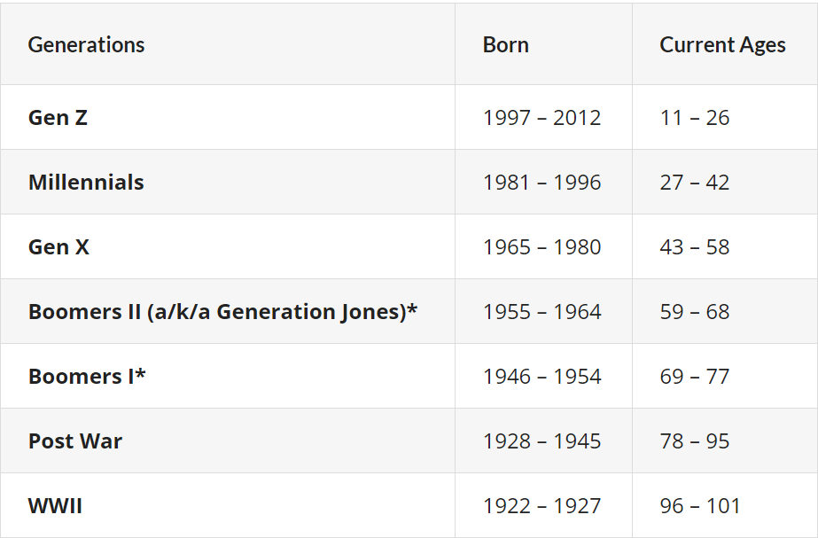
Split the dataset according to generations
Generations defined by name, birth year, and ages in 2023
Age 7-85
group_0_9
group_10_25
group_26_41
group_42_57
group_58_67
group_68_76
group_77_94
Notes:
Speech –
So, as part of our analysis, we're interested in exploring the satisfaction levels across different generations. We want to see if there are any specific issues or significant differences in service ratings for children, adults, and the elderly. Our main focus will be on the mid-age millennials and generations, who make up a significant portion of our customer base. Ultimately, we hope to identify any areas where we can improve our services for different age groups to better meet their needs and enhance their overall satisfaction with our airline.

Slide 21
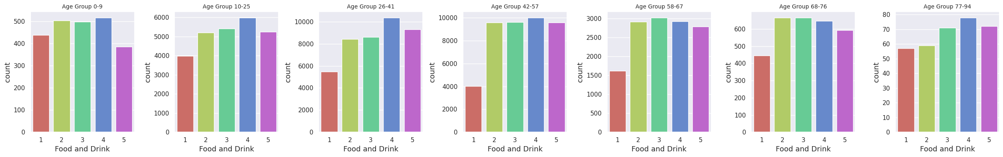
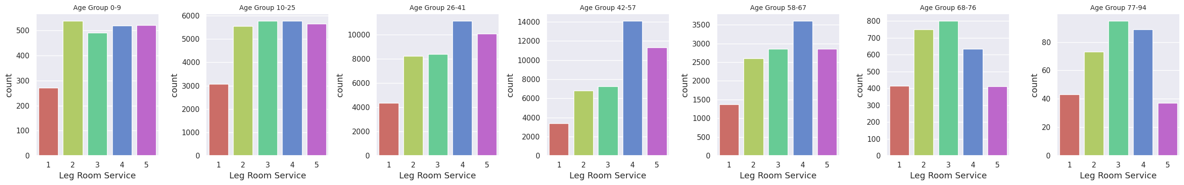
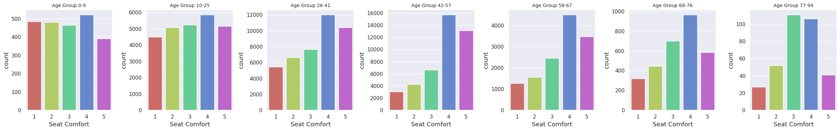
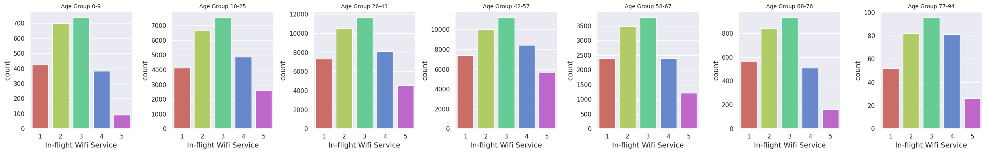
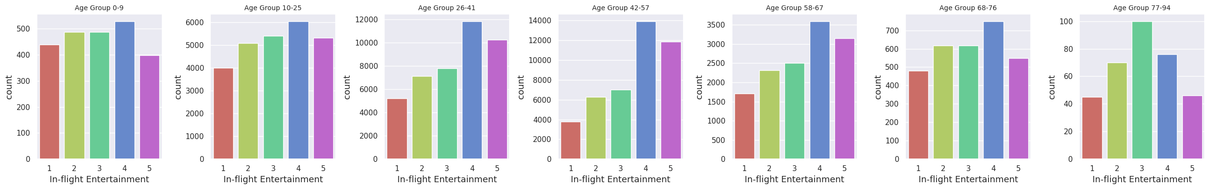
Comparing features that may vary across different age groups
Food and Drink
Leg Room Service
Seat Comfort
In-flight Wifi Service
In-flight Entertainment
Gen Z
Millennials
Gen X
Boomer I
Boomer II
Post War
WWII
Notes:
Speech- Based on our study, we found that Gen Z
and Millennials were satisfied with the spacious legroom, while the elderly reported slight discomfort. This suggests that there is room for improvement in providing more comfortable seating for elderly passengers.
Furthermore, our targeted group of passengers, middle-aged individuals, seemed to be relatively satisfied with the in-flight entertainment and seat comfort but rated other in-flight services as average. Therefore, we recommend improving other in-flight services, such as meals and drinks, to enhance the overall experience for this particular age group.
Overall, the study highlights the need for a comprehensive approach to improving inflight services. By targeting specific areas for improvement based on age groups, airlines can ensure that passengers of all ages have a more satisfactory experience while traveling.

Slide 22

Predicting Key Factors for Airline Customer Satisfaction through Machine Learning
Due to the scattered nature of customer satisfaction data, it can be difficult to identify which areas require improvement or attention.
To address this challenge, we will use machine learning to predict the important features that contribute to customer satisfaction.
By providing airlines with these predictive insights, they can focus on improving specific areas and catering to different generations of customers to enhance overall satisfaction and loyalty
Notes:
When it comes to analyzing customer satisfaction data, there are many variables and it can be difficult to identify what aspects of service are most important to each specific customer group. That's where machine learning comes in. By utilizing this technology, we can predict and determine which features are most important to customers and provide valuable insights to the airline company on which areas they should focus on to maintain or improve the customer experience. This is especially important when trying to attract different generations of customers, as we can identify the areas that each group values the most and cater to their needs accordingly.

Slide 23

Feature Selection: Top 10 features for each age group
Chi-Square – filter out top 15 features
Wrapper Method – features are inherently important in contributing towards the passenger satisfaction
better visualization
Reduces training time
Avoids over-fitting
Improves accuracy of the model
Notes:
Before we preceding to machine learning part, we do feature selection first. Feature selection is an important problem in machine learning, especially in the data sets with many features. It will eliminate unimportant variables and improve the accuracy as well as the performance of classification. Since our dataset contains more than 20 variables so we do feature selection to filter out top 10 features for more accurate prediction.
We use 2 methods for the feature selection where we aim to select the features which are highly dependent on the 'Satisfaction'.
The first method is Chi Square: it helps us to solve the problem in feature selection by testing the relationship between the features. We filter out the top 15 features first, then we use the Wrapper method to check those features are inherently important in contributing towards the passenger satisfaction. Finally, we can combine and conclude the list of important feature from these 2 methods. --> next slide.

Slide 24
Top 10 important features + target: ['Satisfaction'] -->Classification
Datasets name
group_0_9 | 'In-flight Wifi Service', 'Online Boarding', 'Ease of Online Booking', 'Arrival Delay', 'Type of Travel', 'Class', 'Food and Drink', 'In-flight Entertainment', 'Cleanliness', 'Flight Distance'
group_10_25 | 'Online Boarding', 'Type of Travel', 'In-flight Wifi Service', 'Ease of Online Booking', 'Class', 'Food and Drink', 'Arrival Delay', 'In-flight Entertainment', 'Seat Comfort', 'Flight Distance'
group_26_41 | 'Type of Travel', 'Online Boarding', 'Class', 'In-flight Entertainment', 'In-flight Wifi Service', 'Seat Comfort', 'Customer Type', 'Cleanliness', 'Flight Distance', 'Food and Drink'
group_42_57 | 'Type of Travel', 'Class', 'Leg Room Service', 'In-flight Entertainment', 'Online Boarding', 'On-board Service', 'In-flight Wifi Service', 'Flight Distance', 'Baggage Handling', 'Seat Comfort'
group_58_67 | 'Type of Travel', 'Class', 'Leg Room Service', 'In-flight Entertainment', 'In-flight Wifi Service', 'Online Boarding', 'On-board Service', 'Flight Distance', 'Baggage Handling', 'In-flight Service'
group_68_76 | 'Type of Travel', 'In-flight Wifi Service', 'Leg Room Service', 'Arrival Delay', 'In-flight Entertainment', 'Ease of Online Booking', 'Class', 'On-board Service', 'Online Boarding', 'Baggage Handling', 'Flight Distance'
group_77_94 | 'In-flight Entertainment', 'On-board Service', 'In-flight Service', 'Arrival Delay', 'Leg Room Service', 'Cleanliness', 'In-flight Wifi Service', 'Check-in Service', 'Seat Comfort', 'Flight Distance'
Notes:
So we used two methods called chi -square and wrapper to select the most important features for different age groups. These features were then used as predictors to predict the response, which in this case is the level of satisfaction. For example, for the age group 26-41(millennials), the top 10 important features were found to be 'Type of Travel', 'Online Boarding', 'Class', 'In-flight Entertainment', 'In-flight Wifi Service', 'Seat Comfort', 'Customer Type', 'Cleanliness', 'Flight Distance', and 'Food and Drink'. These features have a significant impact on the satisfaction level of this particular age group of passengers.

Slide 25
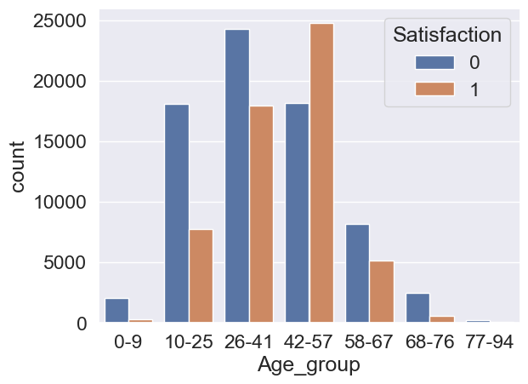
Data Balancing - using Random Over-Sampling
Notes:
We also need to check the balance of the data before building our models.
Class Imbalance is a common problem in machine learning, especially in classification problems. The accuracy of our model can be significantly impacted by imbalanced data. if the dataset has imbalanced classes, then In such cases, we get a pretty high accuracy just by predicting the majority class, but will fail to capture the minority class, which is most often the point of creating the model in the first place.
We can see from the bar chart, the data for each group is very imbalanced and we use over-sampling to handle this issue.
(Why not Undersampling : Undersampling: removing some observations of the majority class. It is a good choice for a ton of data -think millions of rows but the drawback is that may cause a loss of valuable information.)

Slide 26

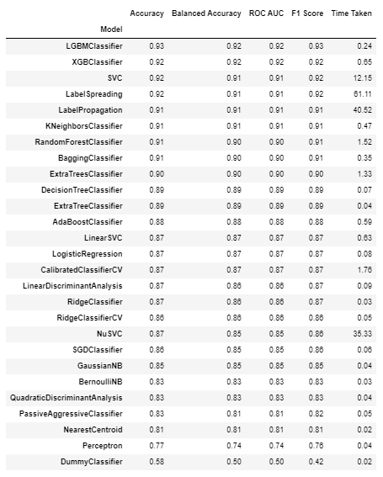
Lazy Predict library
Focusing on one group: group_26_41
Choosing the right algorithm for machine learning
Quick performance comparison with Lazy Predict
Simplified evaluation of multiple algorithms
Time-saving approach for algorithm selection
Informed decision for model performance
Notes:
Lazy Predict is a useful tool for comparing the performance of different machine learning models in Python.
It allows for quick evaluation of multiple algorithms without the need for extensive coding or tuning.
Using Lazy Predict can save time and effort in algorithm selection, leading to more informed decisions and better model performance.
At this stage, we don’t know how to choose an algorithm when training a Machine Learning model, so we decided to use the Lazy Predict library in Python to compare the performance of different Machine Learning models based on classification for all groups. Let's take one group as an example.

Slide 27


Machine Learning
Decision tree
Random forest
Grid-search
LGBM Classifier
Notes:
After implementing lazy predict, we already have the ranking with accuracy of models for each group. Lgbm classifier and random forest seem perform well for most of age groups. So we will use them for our prediction.
based on the results of our LazyPredict analysis and the outcome of the model, the accuracy of the decision tree model may not be as high as other machine learning models across all age groups. Despite this, we decided to implement the decision tree model as our initial prediction model due to its simplicity and ease of understanding.

Slide 28

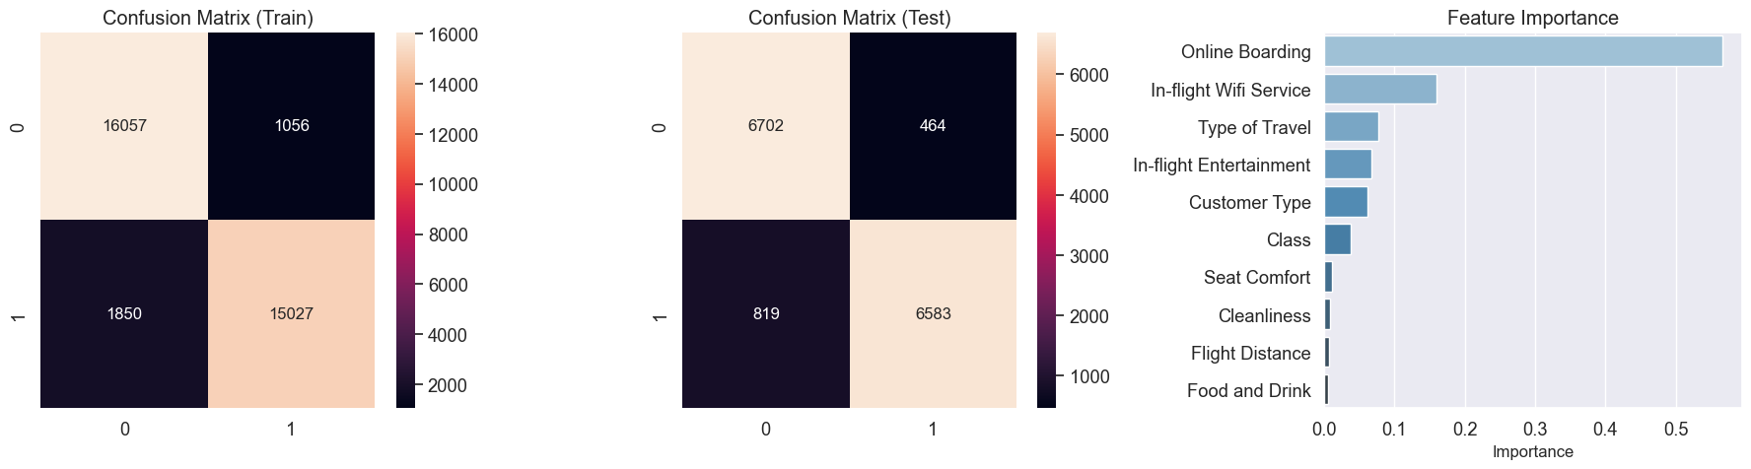
Decision Tree Classifier
group_26_41
The classification accuracy was around 90% for all age groups.
The highest accuracy is for group_77_94 (Train Accuracy: 0.96581 | Test Accuracy: 0.93377)
Notes:
Across all age groups, the classification accuracy was approximately 90%. Notably, the age group categorized as Group_77_94 achieved the highest accuracy among all groups, with a training accuracy of 0.96 and a testing accuracy of 0.93. But the result from Lazypredict is 75% so that means Lazy prediction is not perfect, and sometimes its results can be inaccurate.
If you notice that your predictions are off, try adjusting your parameters or using a different algorithm. Also from the outcome of lazypredict for group_77_94, we can see the overall accuracy is the lowest among all groups that is maybe due to less data within this group.

Slide 29
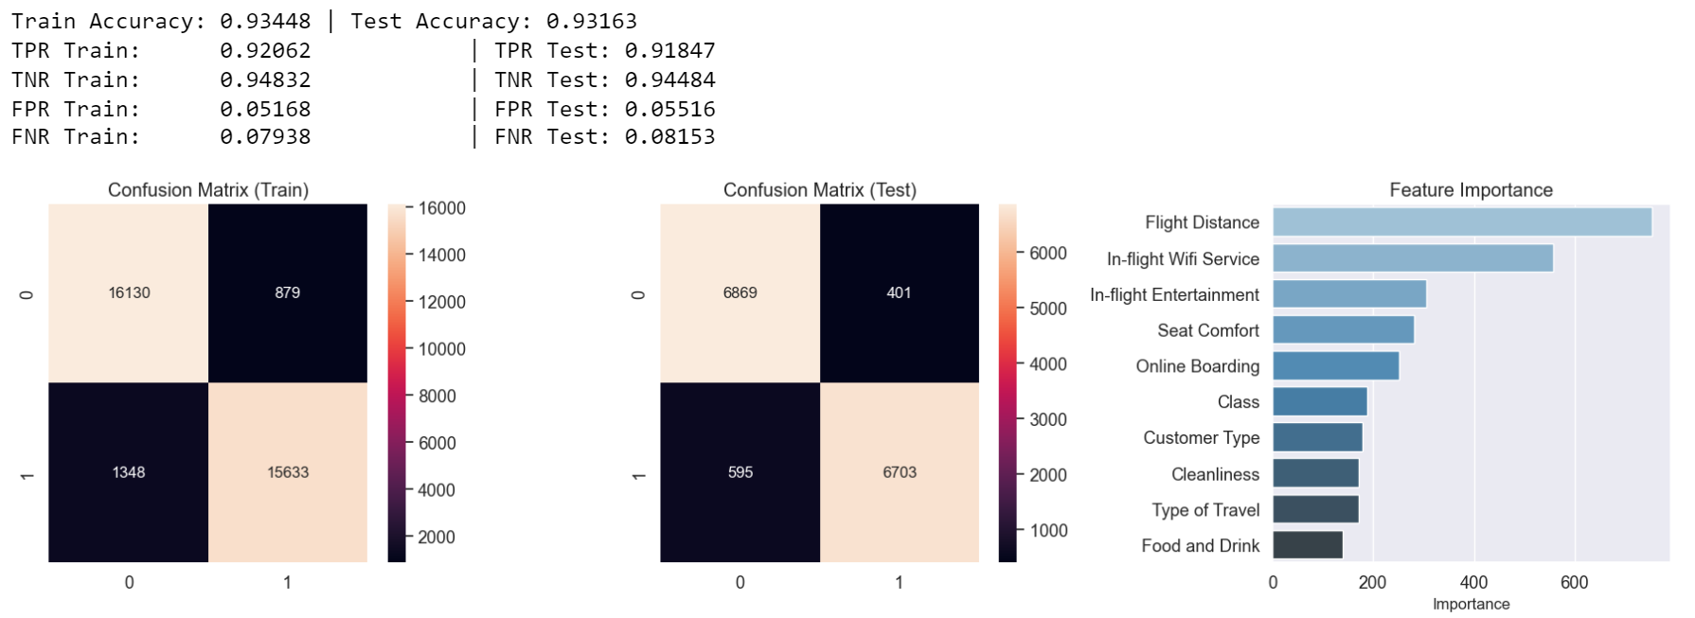
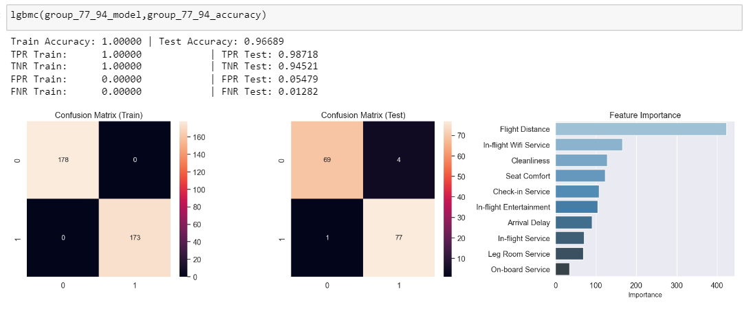
LightGBM Classifier
Faster training speed and higher efficiency.
Lower memory usage.
Better accuracy.
group_26_41
group_77_94
Overfitting
reasons: training data size is too small
Notes:
This is the data for group_26_41 which shows similar result for train and test accuracy(93%) so there is no over-fitting.
Also, this model perform well for all age groups.
One thing need to note, the train result for group_77_94 is exactly 1 so it means this model might be overfitting. Overfitting happens in this case maybe due to The training data size is too small and does not contain enough data samples to accurately represent all possible input data values.

Slide 30
LightGBM Classifier
Faster training speed and higher efficiency.
Lower memory usage.
Better accuracy.
group_26_41
group_77_94
Overfitting
reasons: training data size is too small
Notes:
This is the data for group_26_41 which shows similar result for train and test accuracy(93%) so there is no over-fitting.
Also, this model perform well for all age groups.
One thing need to note, the train result for group_77_94 is exactly 1 so it means this model might be overfitting. Overfitting happens in this case maybe due to The training data size is too small and does not contain enough data samples to accurately represent all possible input data values.

Slide 31
LightGBM Classifier
Faster training speed and higher efficiency.
Lower memory usage.
Better accuracy.
group_26_41
group_77_94
Overfitting
reasons: training data size is too small
Notes:
This is the data for group_26_41 which shows similar result for train and test accuracy(93%) so there is no over-fitting.
Also, this model perform well for all age groups.
One thing need to note, the train result for group_77_94 is exactly 1 so it means this model might be overfitting. Overfitting happens in this case maybe due to The training data size is too small and does not contain enough data samples to accurately represent all possible input data values.

Slide 32
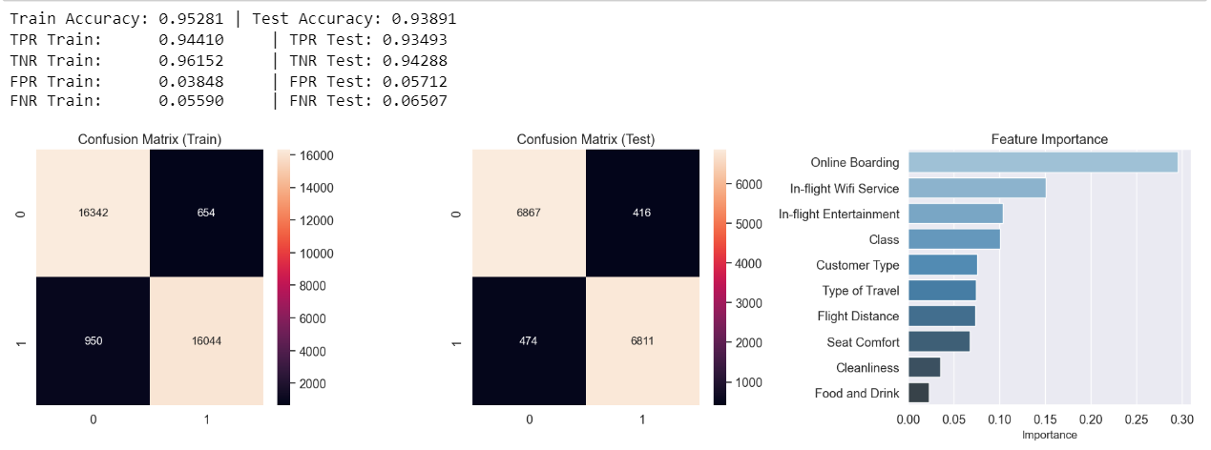
After Cross-Validation Grid Search -
Random Forest with best hyperparameter
 | group_0_9 | group_10_25 | group_26_41 | group_42_57 | group_58_67 | group_68_76 | group_77_94
n_estimators | 500 | 900 | 600 | 600 | 1000 | 1000 | 600
max_depth | 14 | 14 | 14 | 14 | 14 | 14 | 13
best_score | 0.95480 | 0.91838 | 0.93663 | 0.95649 | 0.96116 | 0.96315 | 0.94298
group_26_41:
Notes:
Prior to implementing the random forest model, we have decided to determine the optimal hyperparameters for each age group in order to achieve higher accuracy in our predictions. This approach involves tuning the model's parameters to optimize its performance on each specific age group. By fine-tuning the hyperparameters, we can potentially increase the accuracy of the model's predictions, resulting in more reliable and precise outcomes.
We using the result getting from Grid search for random forest model, here is the accuracy for group_26_41. After these 3 models, we are comparing the accuracy for all models for each groups. ->next slide

Slide 33
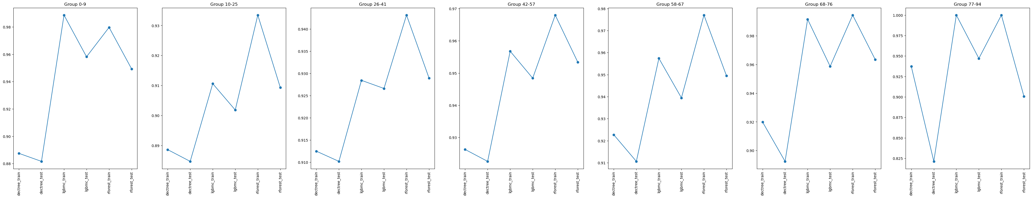
Accuracy comparison
Among these 3 models, we can see from this graph that we can consider random forest with grid search as the best model for our prediction.
Notes:
We can see from the chart, random forest with best hyperparameter perform best overall. So we consider it as our best model for the prediction.

Slide 34
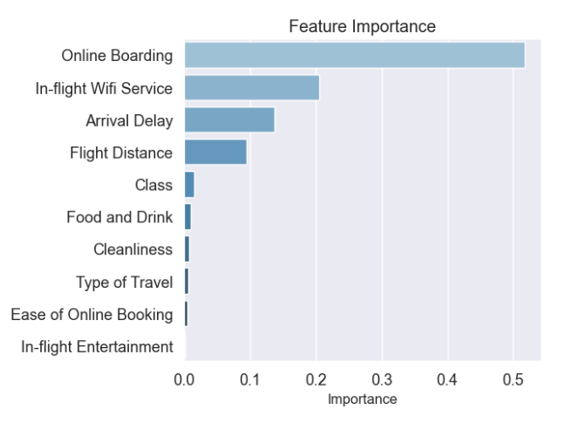
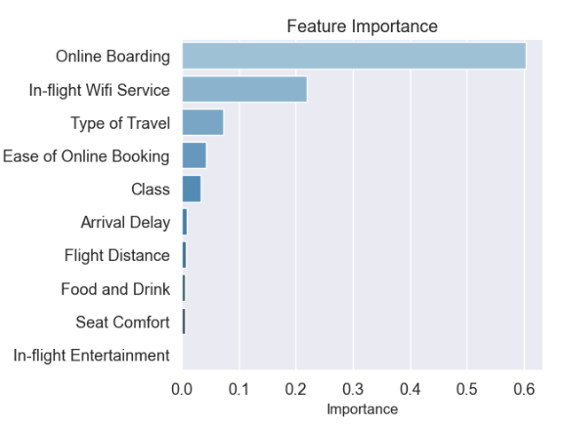
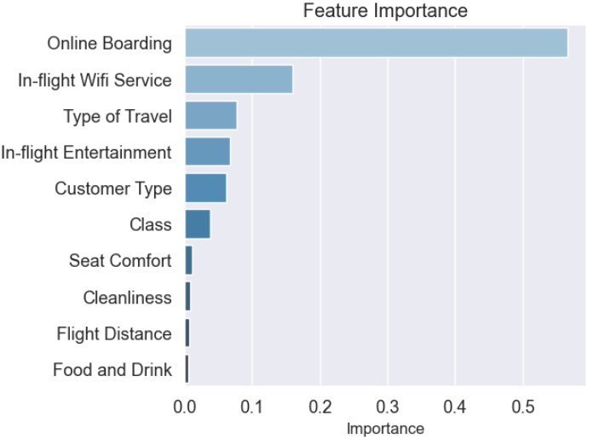
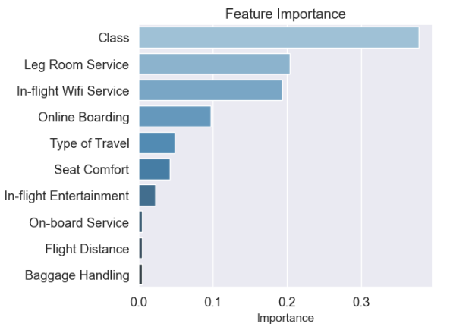
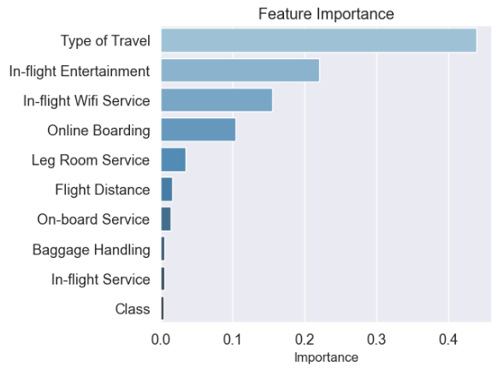
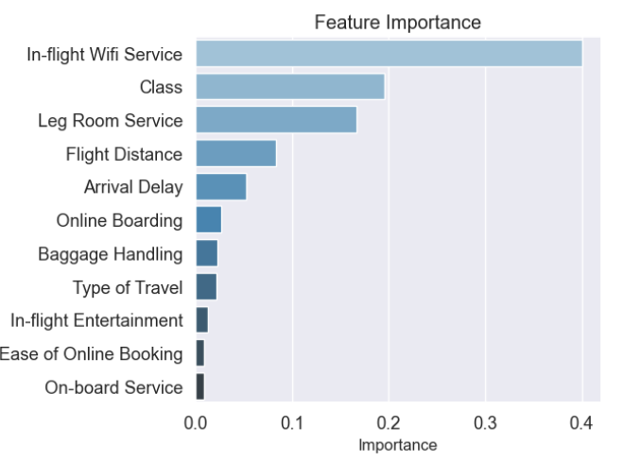
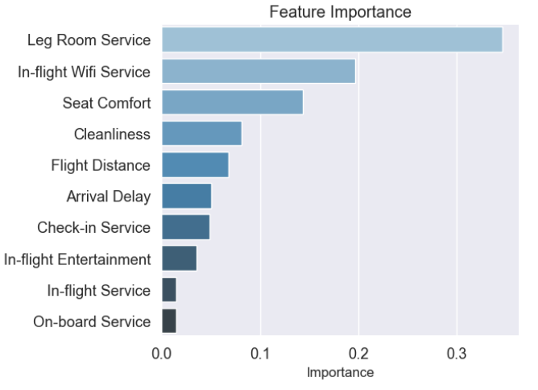
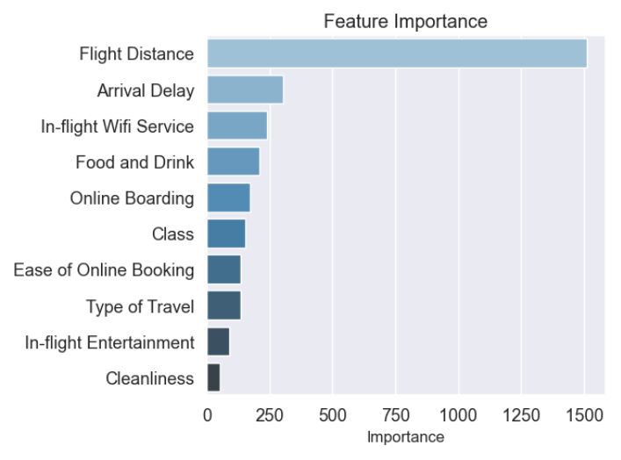
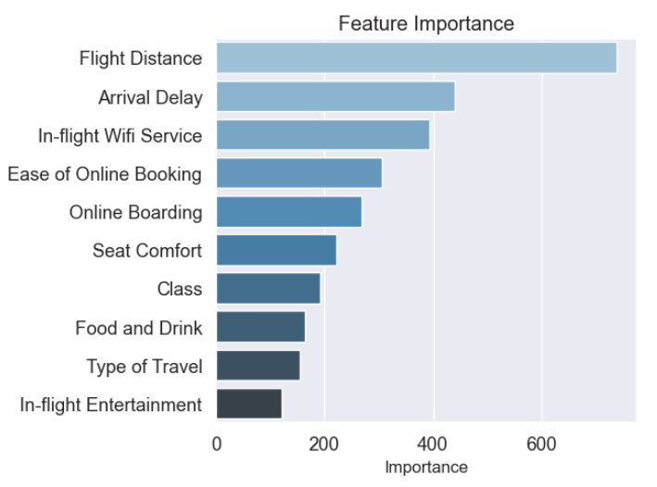
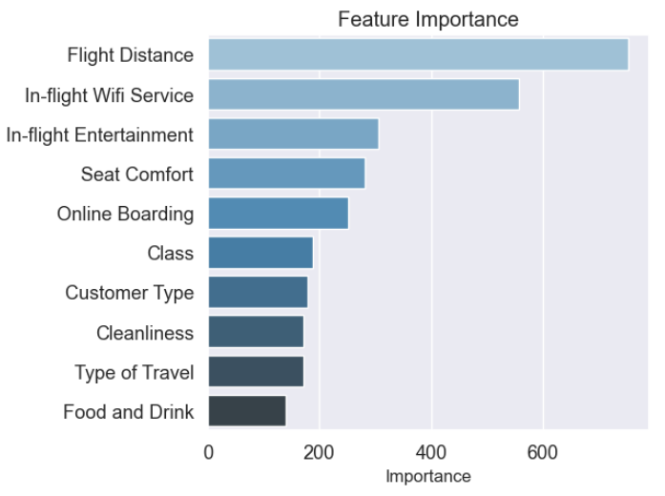
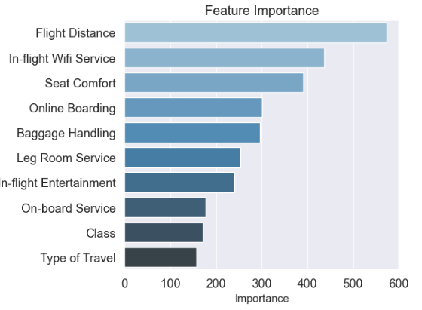
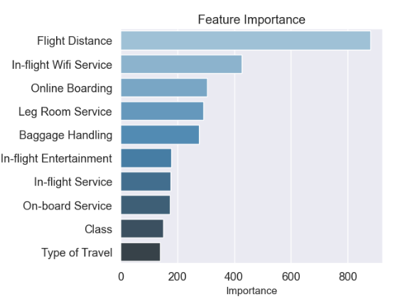
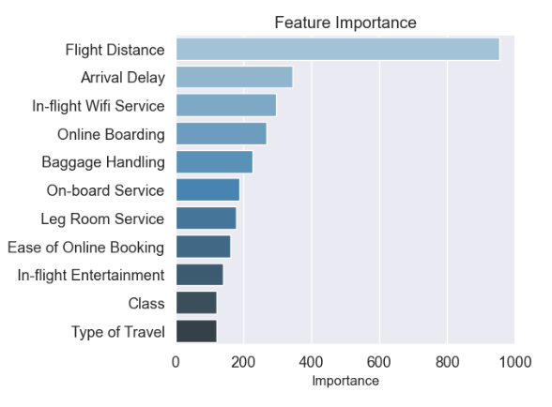








Feature importance
group_0_9
group_10_25
group_26_41
group_42_57
group_58_67
group_68_76
group_77_94
Decision Tree Classifier
LightGBM Classifier
Random Forest with GridSearch
Notes:
Here is we are using feature importance to check the importance of variables for these 3 models.
Let us focusing on one group – group_26_41.
online boarding and WiFi services significantly are the important variables for decision tree.
Flight distance and wifi are important factors for the LGBMclassifier model.
For the Random Forest model, the features that stand out are online boarding and WiFi which is same as decision tree.
Based on the analysis of different machine learning models, it can be concluded that passengers aged between 26 to 41 years consider online boarding and WiFi services as crucial factors for their flight satisfaction.

Slide 35

Conclusion
Recommendations
Focusing on providing efficient online boarding and WiFi services
Other factors:
Class
Leg Room Service
Type of Travel
Notes:
After completing the project, we have addressed our main problem, which is identifying how various variables impact overall satisfaction in different generational groups. To accomplish this, we did EDA that demonstrated the connection between the variables and satisfaction. Additionally, we implemented feature selection and feature importance techniques during modeling to determine which features had the most significant impact on passenger satisfaction. Based on our findings, we have compiled a list of the most influential features.
In conclusion To enhance passenger satisfaction levels, it is recommended that the airline improve their Wi-Fi service and online boarding, as this is a crucial factor for all generations.
Additionally, airlines should also consider other factors such as class, leg room, and arrival delay to enhance the flight experience for different age groups. Regarding the class of service, our analysis indicates that airlines should prioritize improving their services for economy class passengers. This is supported by our findings in the EDA part, which revealed that aspects such as leg room service and type of travel are closely related to the class of service. Specifically, we found that a majority of business class passengers rated the leg room service highly, and that individuals traveling for business purposes tend to opt for the business class.
While flight distance appears to have a significant impact on passenger satisfaction levels, it is important to note that this is not a feature that the airline can improve upon, as it is not a service that is directly provided by the airline company.

